Slide 1
Intro to Diffusion Models
Accelerate Programme for Scientific Discovery

Slide 2
Diffusion Models
Overview
Taking inspiration from statistical physics
Stable Diffusion
The diffusion algorithm
VAEs
UNet
Clip
The diffusion algorithm…again.

Slide 3
Inspiration from Physics
Notes:
My name is Ryan and I’m a machine learning engineer with the accelerate programme for scientific discovery. I’m just going to talk about accelerate, what we do, what we’ve done, and what we might be able to offer you.

Slide 4
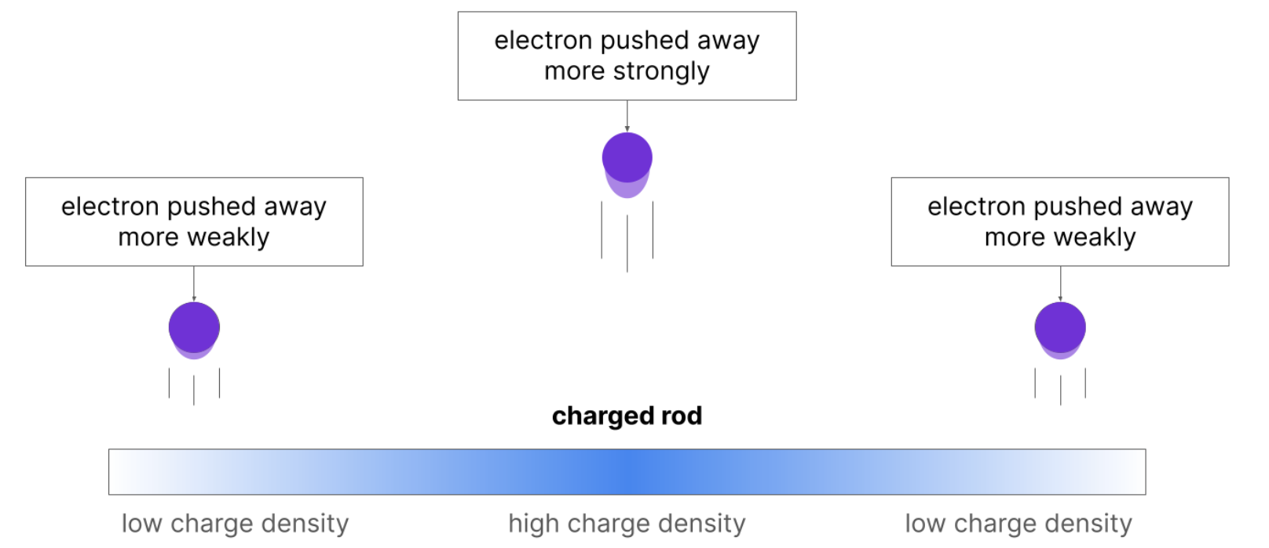
Inspiration from Physics
Charge distributions
Charge densities are objects that have different amounts of charge depending on where you are on the object.
High charge repels electrons strongly, low charge repels electrons weakly:

Slide 5
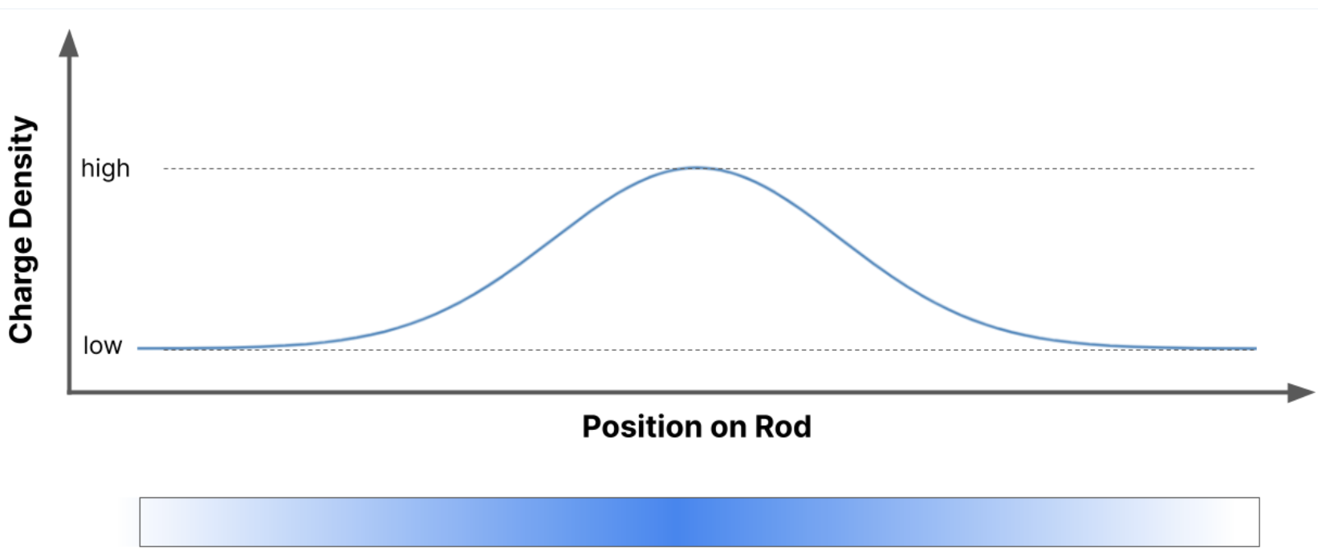
Inspiration from Physics
Charge distributions
If we plot the distribution in the previous slide, we get a Gaussian distribution (roughly)

Slide 6
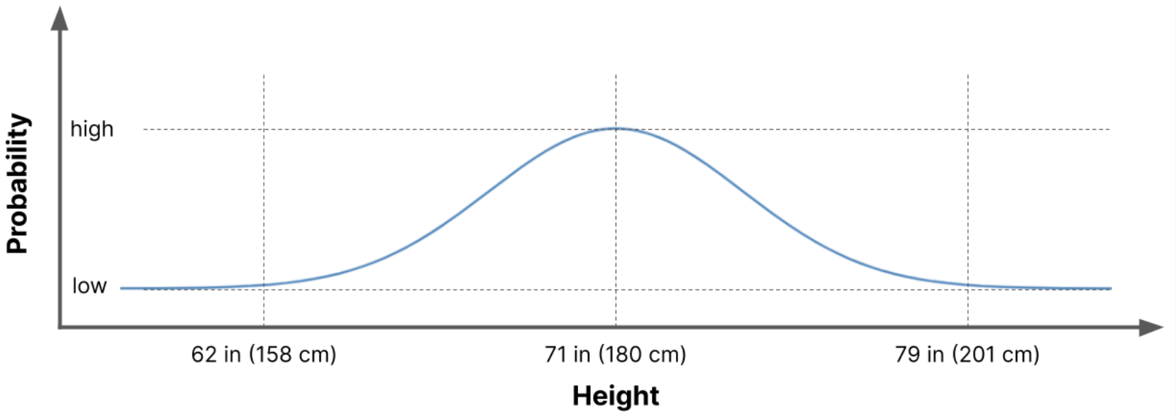
Inspiration from Physics
Probability distributions
Instead of charge density, we can look at how likely the value of something is
This probability density distribution shows the height of human males:

Slide 7
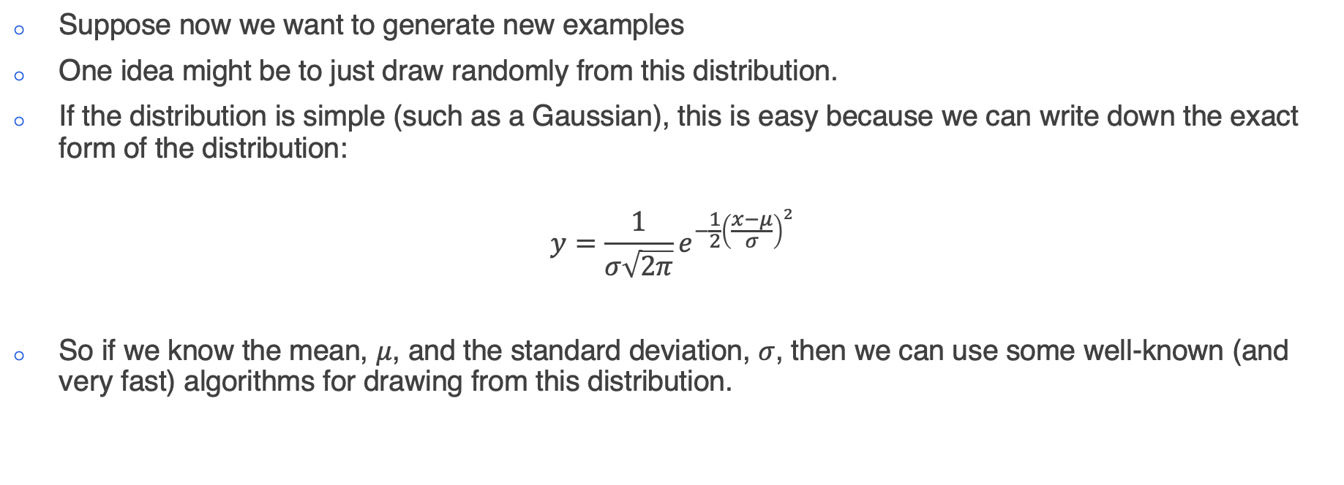
Inspiration from Physics
Generating new data
Suppose now we want to generate new examples
One idea might be to just draw randomly from this distribution.
If the distribution is simple (such as a Gaussian), this is easy because we can write down the exact form of the distribution:
$$y=\frac{1}{σ\sqrt{2π}}e^{−\frac{1}{2}{\left(\frac{x−μ}{σ}\right)}^{2}}$$
So if we know the mean, $μ$, and the standard deviation, $σ$, then we can use some well-known (and very fast) algorithms for drawing from this distribution.

Slide 8
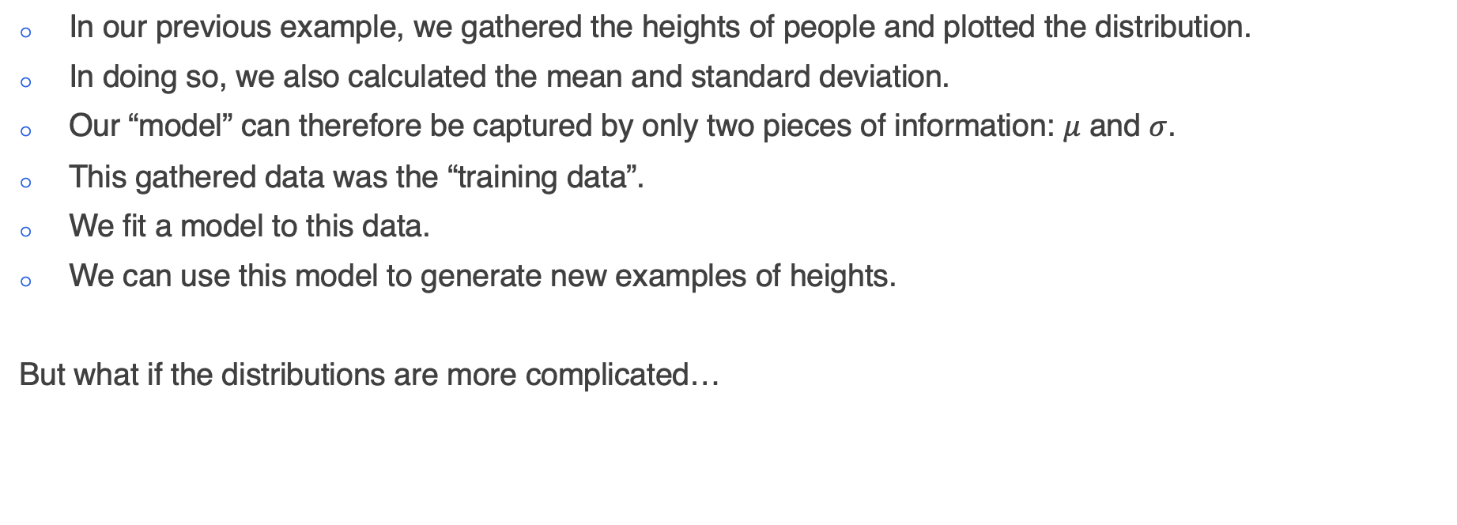
Inspiration from Physics
The training data
In our previous example, we gathered the heights of people and plotted the distribution.
In doing so, we also calculated the mean and standard deviation.
Our “model” can therefore be captured by only two pieces of information: $μ$ and $σ$.
This gathered data was the “training data”.
We fit a model to this data.
We can use this model to generate new examples of heights.
But what if the distributions are more complicated…

Slide 9
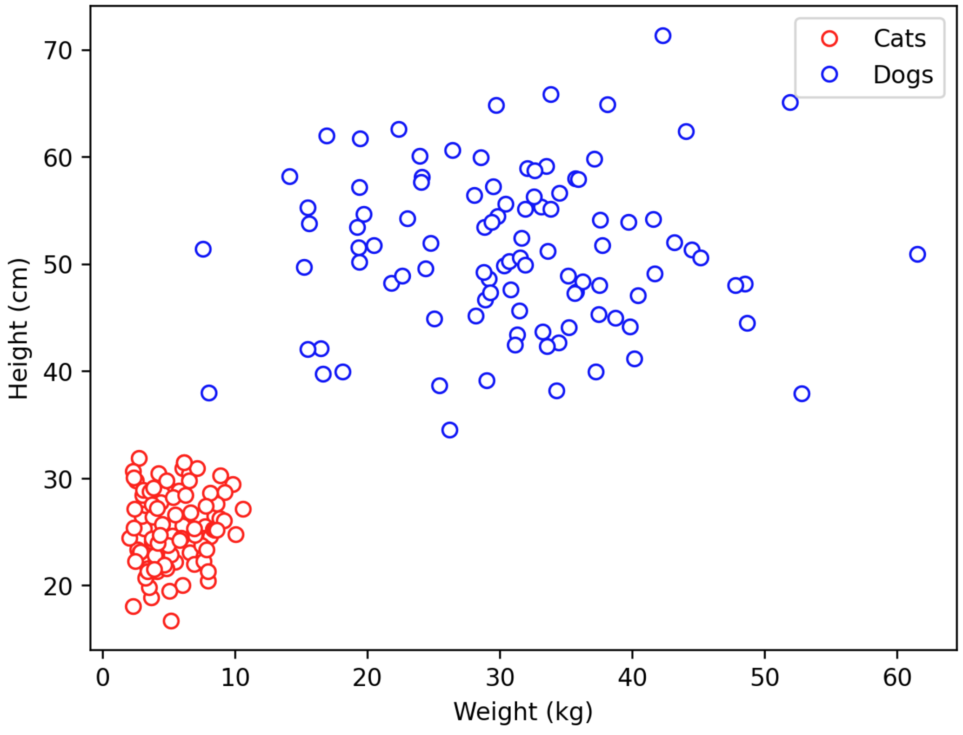
Inspiration from Physics
More complicated distributions
Here is a plot of the height and weight distributions of cats and dogs
Cats are typically smaller and lighter than dogs
We don’t really see much variety in the size and shapes of cat, but dogs can vary quite a lot!

Slide 10
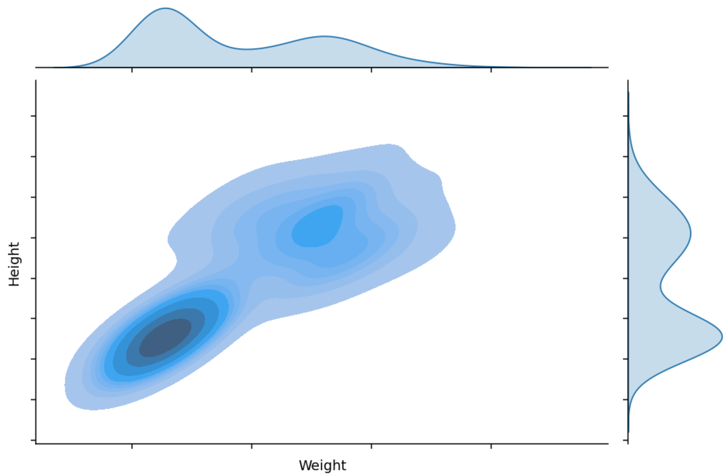
Inspiration from Physics
More complicated distributions
But how am I supposed to write down the equation to this distribution!
I could guess, and say that it looks like a mixture of two Gaussians.
But what about when we step into higher dimensions and I can’t physically look at the distribution of the data…?
Notes:
Assumption that your distribution is a mixture of gaussians

Slide 11
Inspiration from Physics
Let’s revisit the idea of data as a charge distribution…
We have a complicated probability distribution
Let’s now imagine that this is a charge distribution instead
Areas of high charge are strongly repellent
This will cause the distribution to “repel itself” and spread out
As we let this happen for a very long time, it will be very difficult to make out any structure
Here is an example:

Slide 12
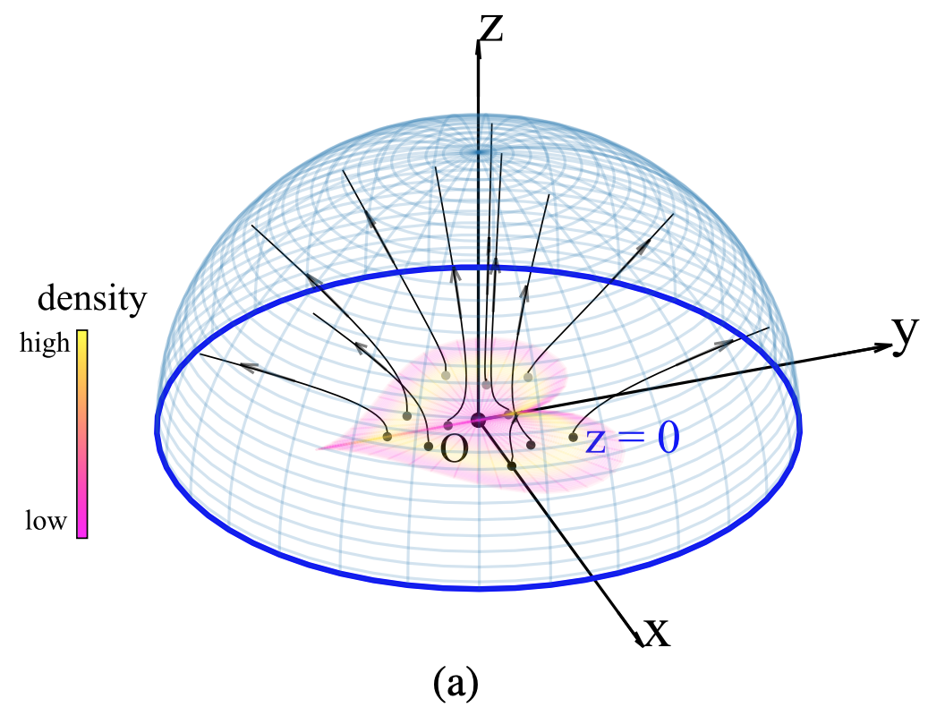
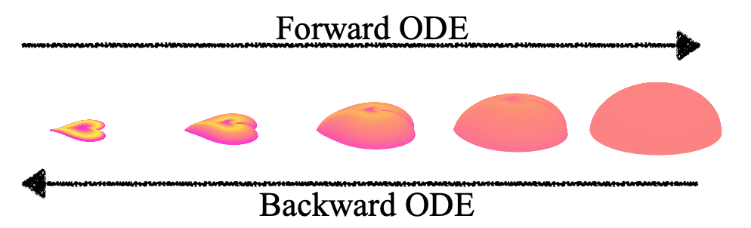
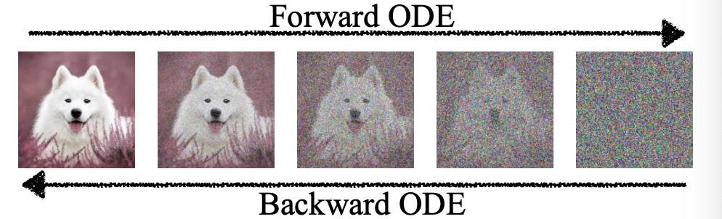
Inspiration from Physics
Start with a complicated distribution…

Slide 13
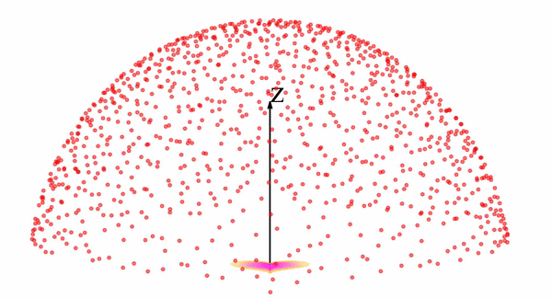
Inspiration from Physics

Slide 14
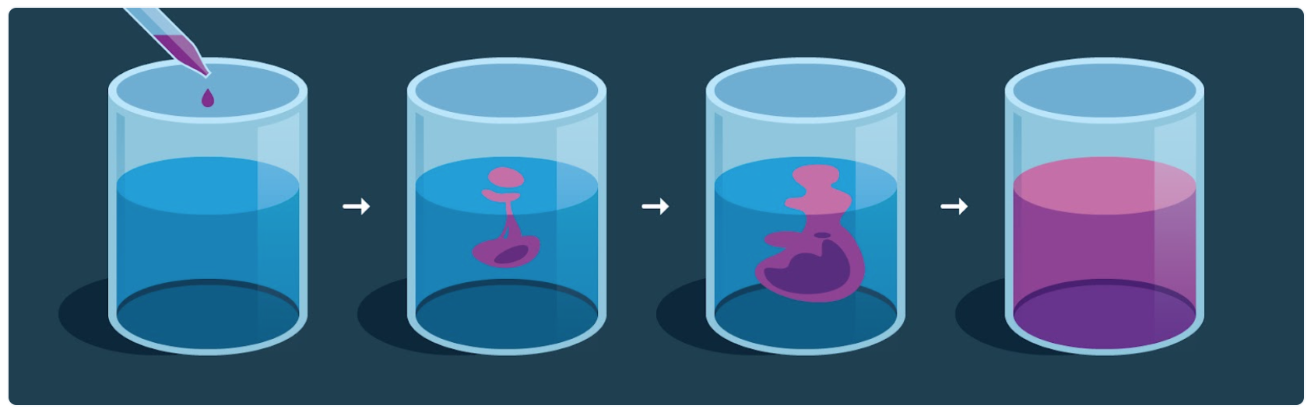
Inspiration from Physics
Another example, this time from statistical physics
Notes:
Think about what happens when you mix milk with coffee…
In the first instance, you drop some milk into the coffee, and it is all concentrated in one location, and the pattern it makes is very complicated. There are only very limited numbers of ways that the cup of coffee can make this pattern.
Conversely, when you let the coffee sit for a while, the milk will disperse evenly throughout the coffee, and what you are left with is a uniform distribution of milk (and probably a cold cup of coffee).
This process is diffusion.

Slide 15
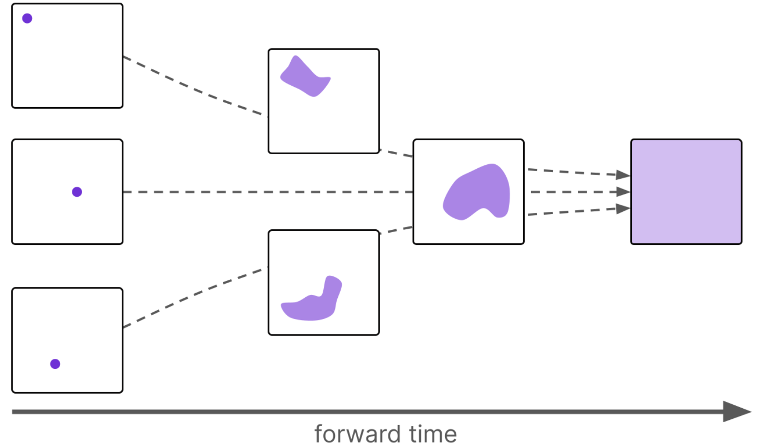
Inspiration from Physics
Regardless of where we place the initial milk drop, the end result is the same…

Slide 16
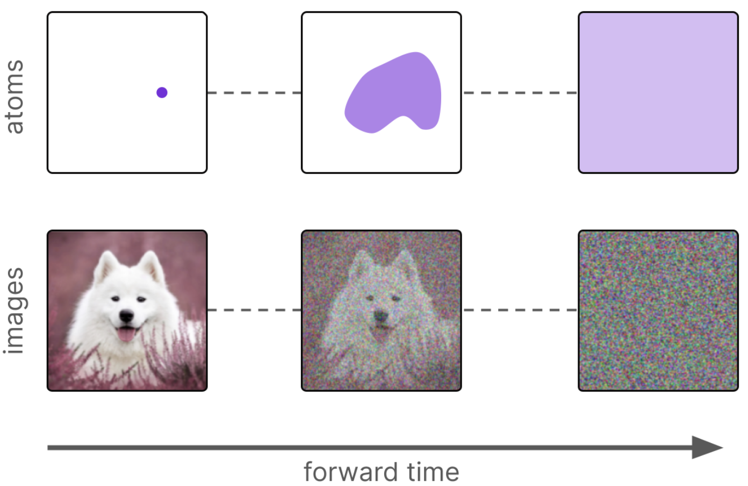
Inspiration from Physics
Coffee or pixels in an image…

Slide 17
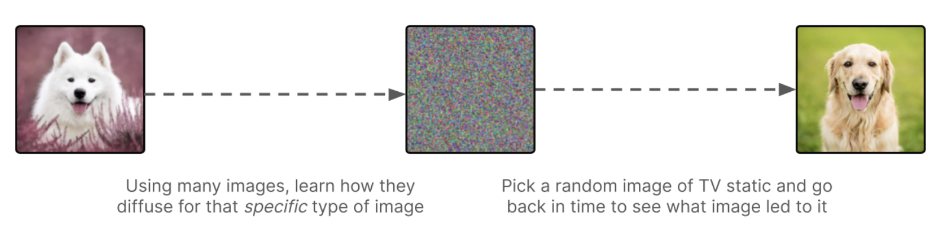
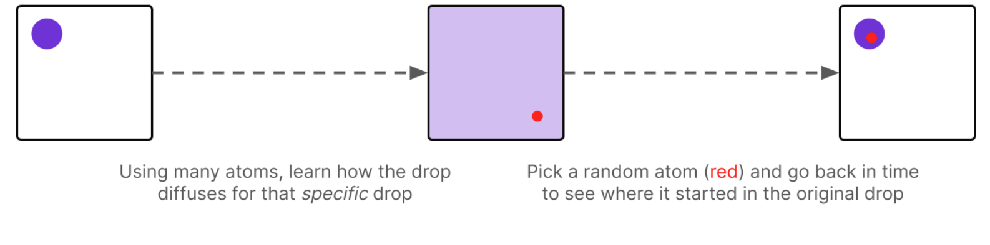
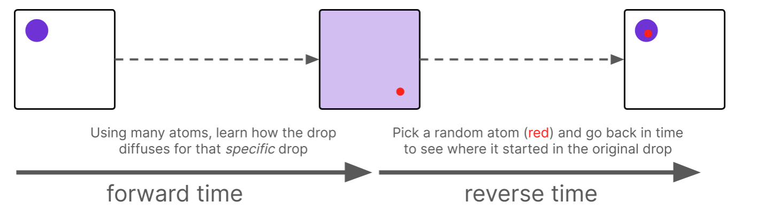
Inspiration from Physics
This is great, but why does it help us…?
We saw with the cats and dogs, that it is difficult to sample from this distribution, because we cannot write down the equation of the distribution…
But we can sample from a Normal distribution very easily…

Slide 18
Diffusion
Notes:
My name is Ryan and I’m a machine learning engineer with the accelerate programme for scientific discovery. I’m just going to talk about accelerate, what we do, what we’ve done, and what we might be able to offer you.

Slide 19
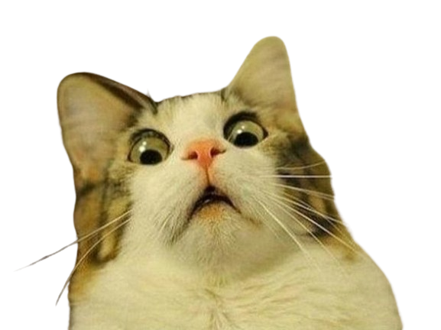
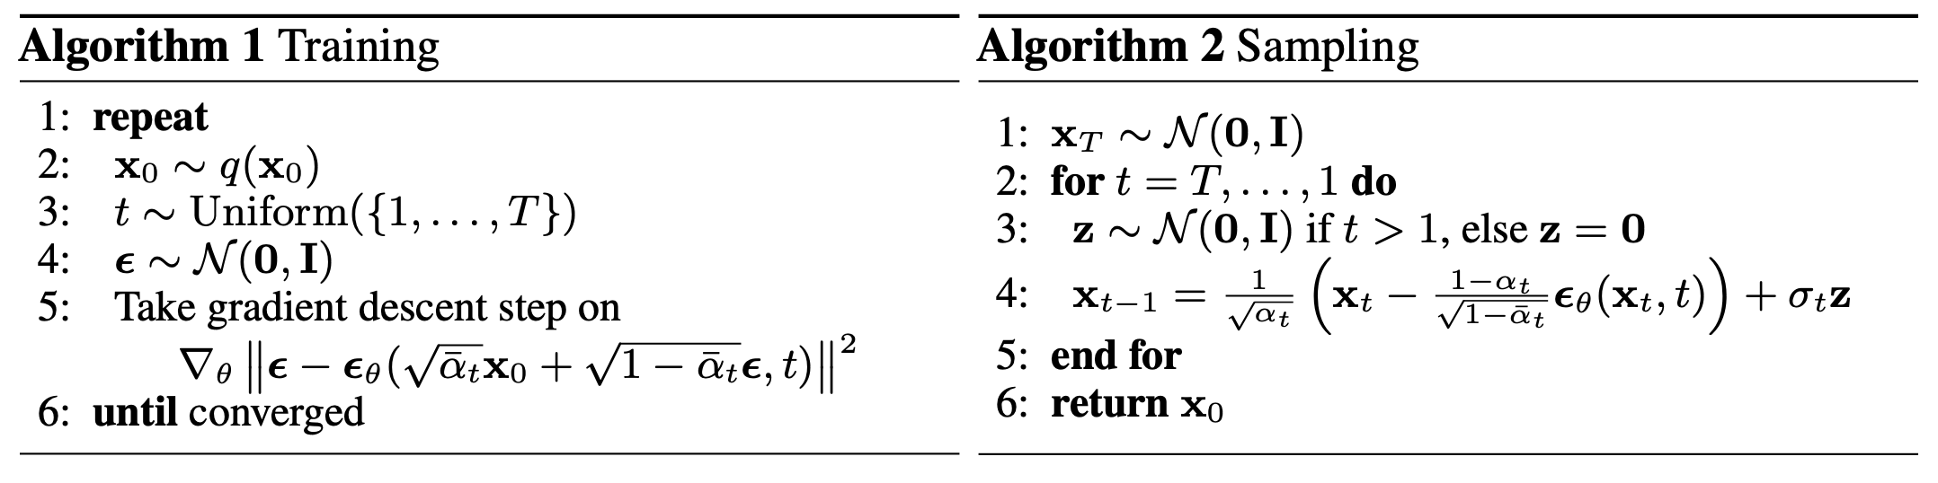
Diffusion
Here is the algorithm for diffusion…
Notes:
By the end of the session today, I’m hoping that we can get at least a general idea of what these steps mean, without really caring too much about the mathematical detail…I’ll briefly explain the left hand algorithm now. It might not make too much sense immediately, but hopefully, later on, it should.
Get a random training sample
Draw a timestep uniformly at random from [1, T]
Generate some noise from a normal distribution
Feed your image plus noise into the model. The model will then try this noise value

Slide 20
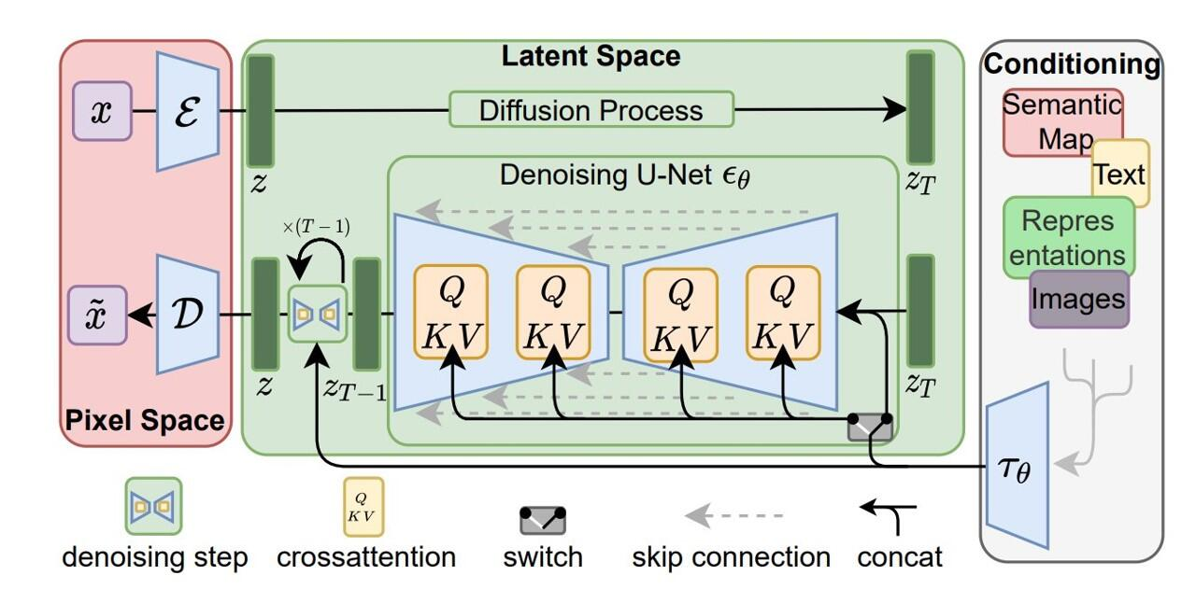
Diffusion
Perhaps this makes more sense…

Slide 21
Diffusion
Aims of this section:
By the end of the session we want to be able to understand the algorithm and the architecture.
We start with the architecture:
Variational Autoencoders
UNet
CLIP
Then we piece together the algorithm.

Slide 22
Variational Autoencoders
Notes:
My name is Ryan and I’m a machine learning engineer with the accelerate programme for scientific discovery. I’m just going to talk about accelerate, what we do, what we’ve done, and what we might be able to offer you.

Slide 23
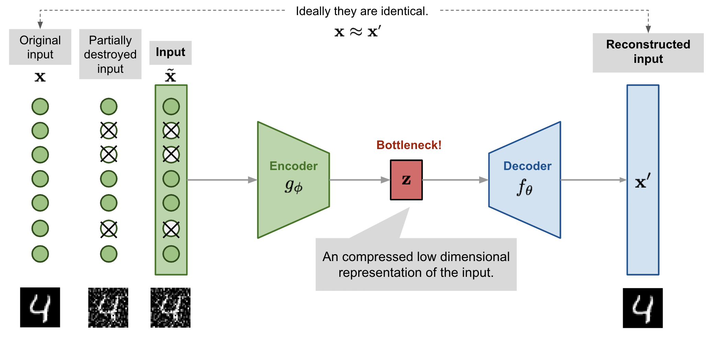
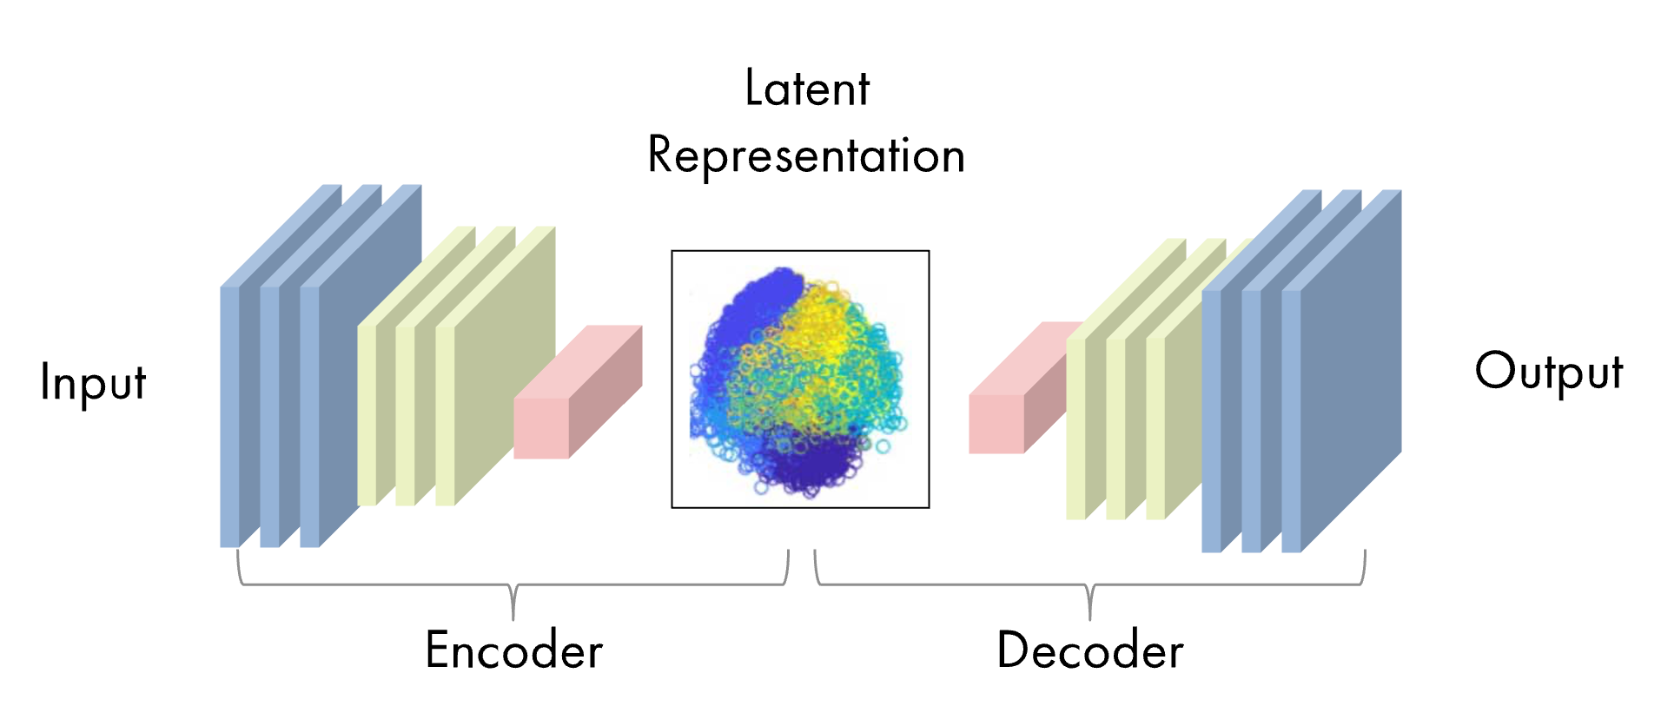
VAEs
A simple example…
Suppose you want to create a neural network that denoises images.
One way of doing this is by using an autoencoder…
Notes:
Pay attention to this structure, because it is going to come up again and again.

Slide 24
VAEs
But there are some issues with using this kind of autoencoder…
Gaps between latent points, where the model doesn’t really know what is supposed to be there
It is deterministic – the encoder will map input data to a single point in latent space and then decode it back to the original space.
This mapping limits the ability to generate samples
They are not really trying to model the underlying data distribution

Slide 25
VAEs
Instead of trying to build a latent space encoding, why not try and model a distribution…
We should try and map the input space to a latent distribution rather than a single point in space
We should therefore have a continuous and dense latent space
This will enable smooth interpolation between points
We impose restrictions on the latent space to force it to map the input data to the distribution that we want.
This distribution is the normal distribution. This is because we can draw from it easily, and computing gradients is also easy.

Slide 26
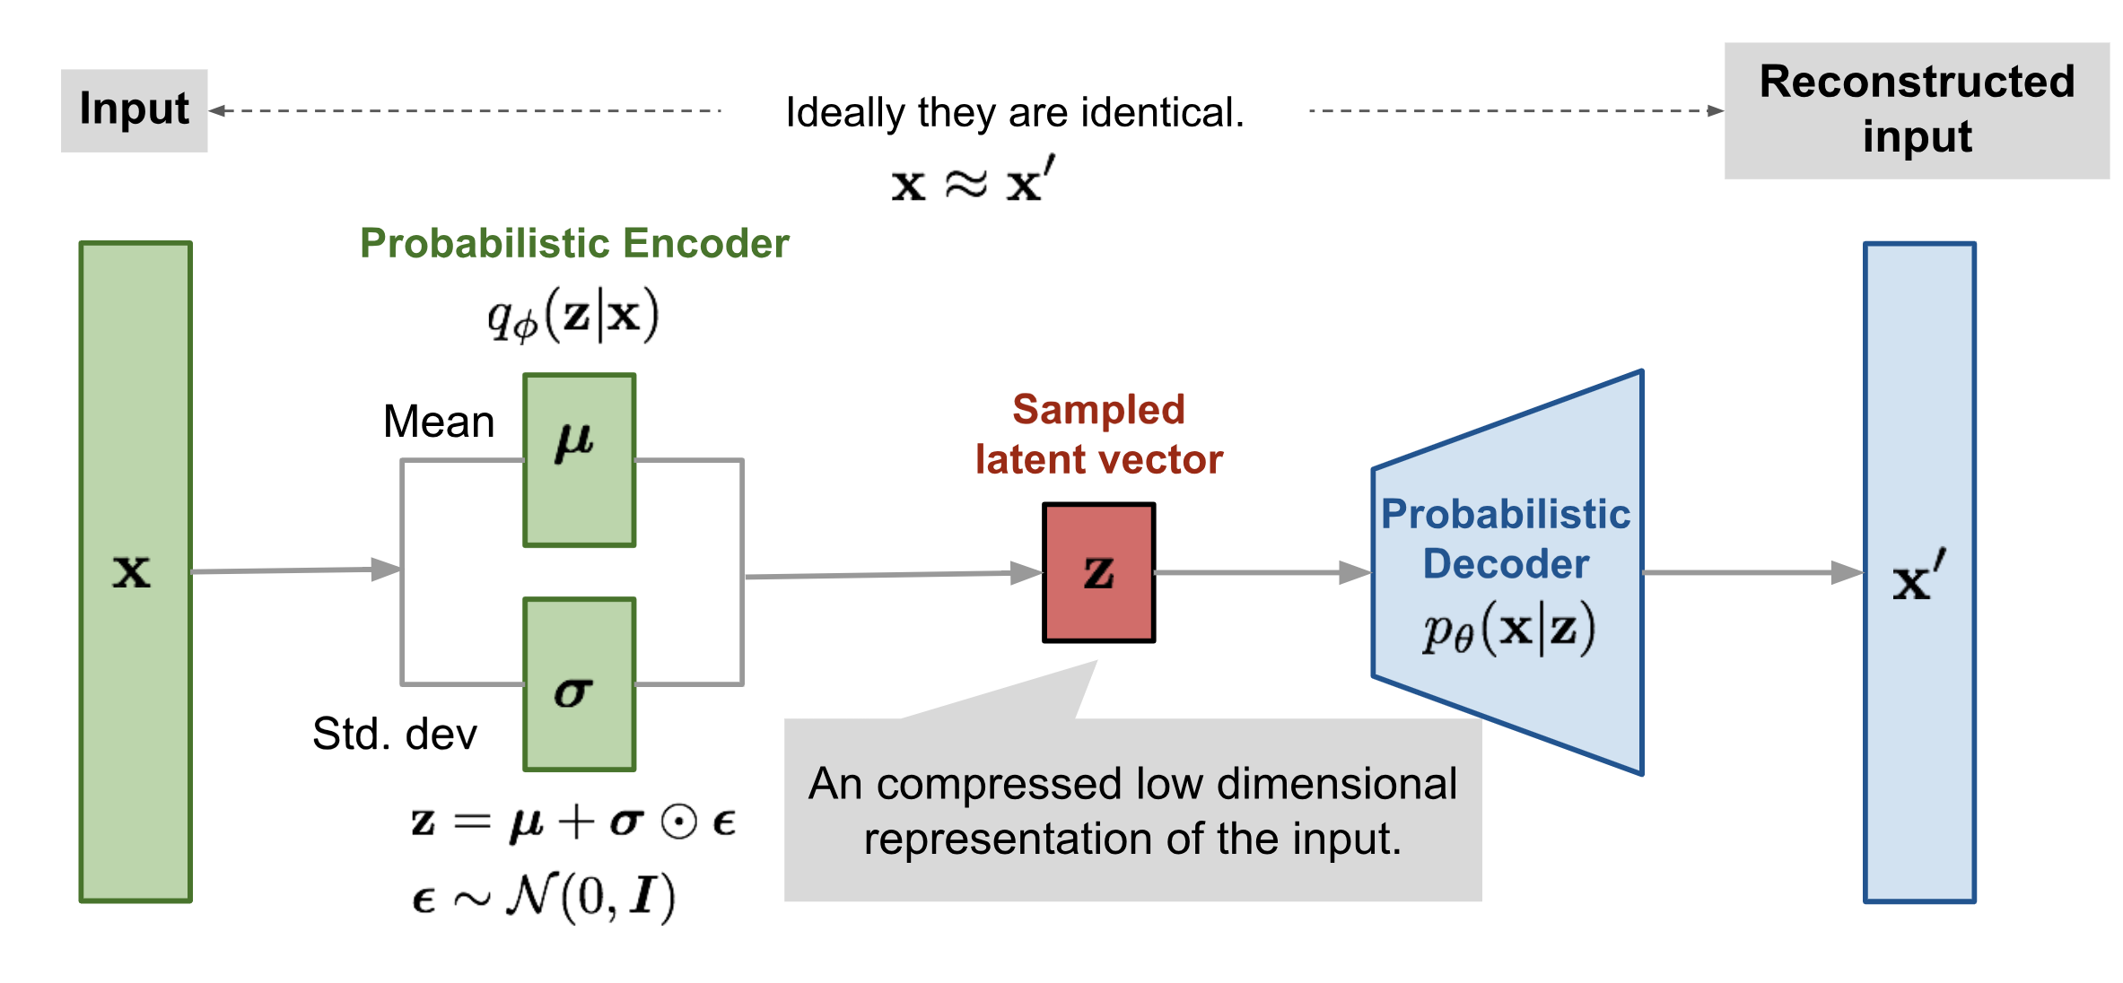
VAEs

Slide 27
U-Net
Notes:
My name is Ryan and I’m a machine learning engineer with the accelerate programme for scientific discovery. I’m just going to talk about accelerate, what we do, what we’ve done, and what we might be able to offer you.

Slide 28
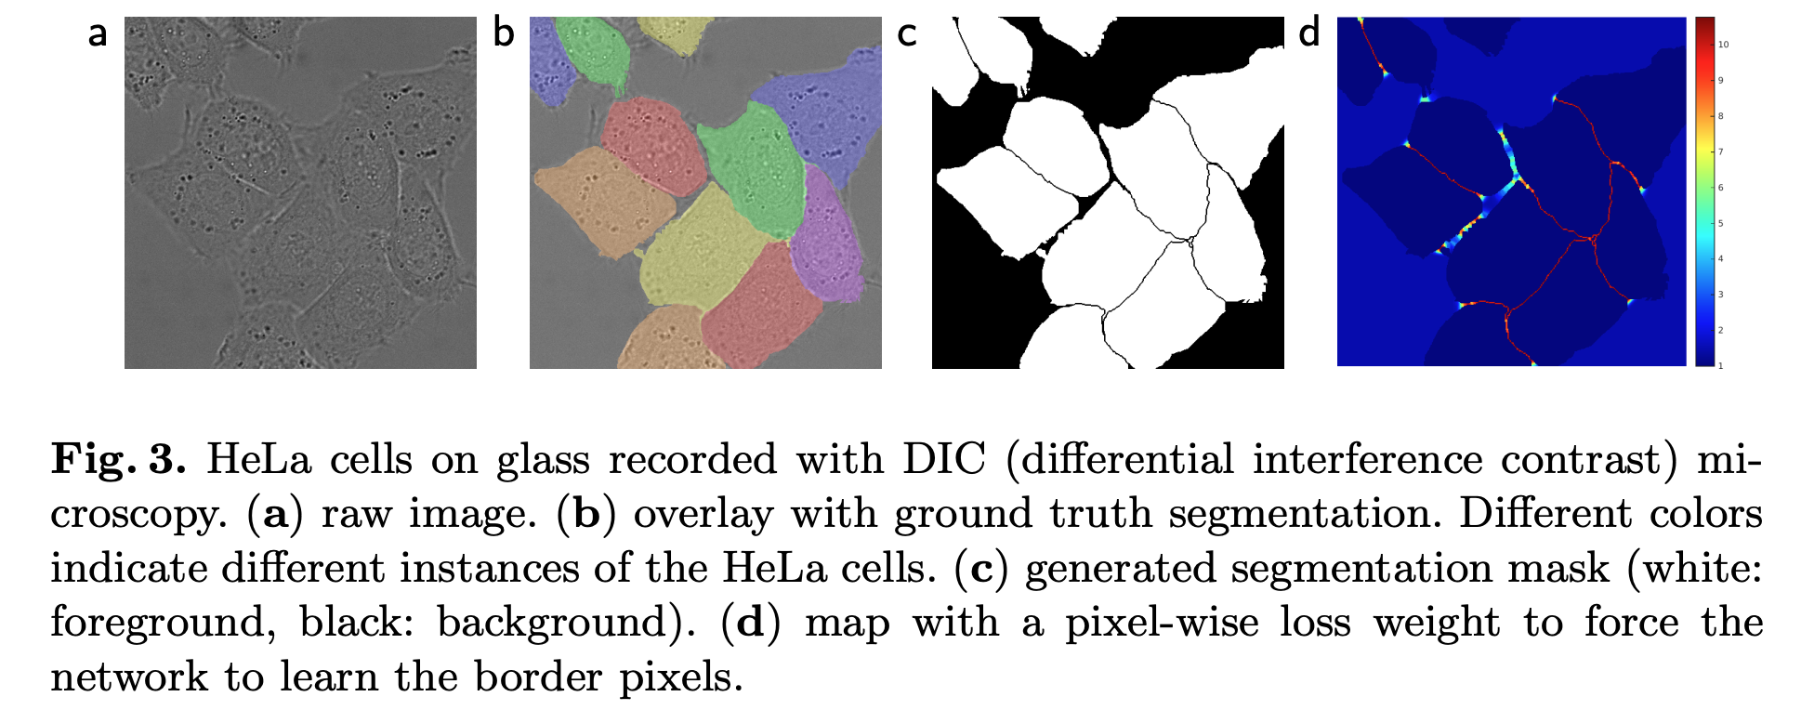
U-Net
U-Net was originally developed for biomedical image segmentation.
The original paper U-Net: Convolutional Networks for Biomedical Image Segmentation was presented at MICCAI in 2015, and now has nearly 85k citations!

Slide 29
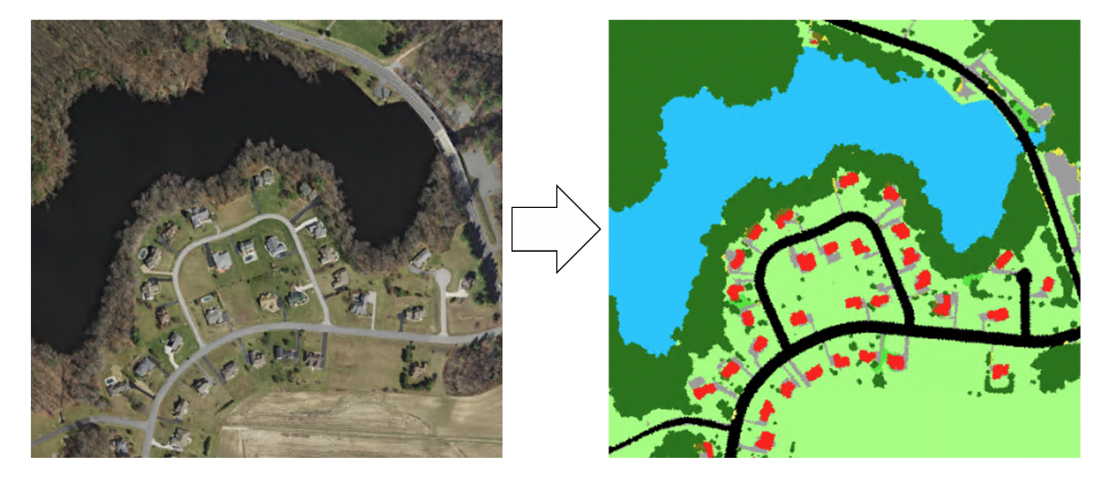
U-Net
U-Net was originally designed for semantic segmentation
The input data consists of the original image
For the label data, each corresponding pixel is given a label.
0.54 | 0.64 | 0.36 | 0.58 | 0.48
0.90 | 0.89 | 0.91 | 0.87 | 0.89
0.91 | 0.90 | 0.85 | 0.89 | 0.90
0.46 | 0.48 | 0.59 | 0.56 | 0.47
0.54 | 0.64 | 0.36 | 0.58 | 0.48
grass | grass | grass | grass | grass
road | road | road | road | road
road | road | road | road | road
grass | grass | grass | grass | grass
grass | grass | grass | grass | grass

Slide 30
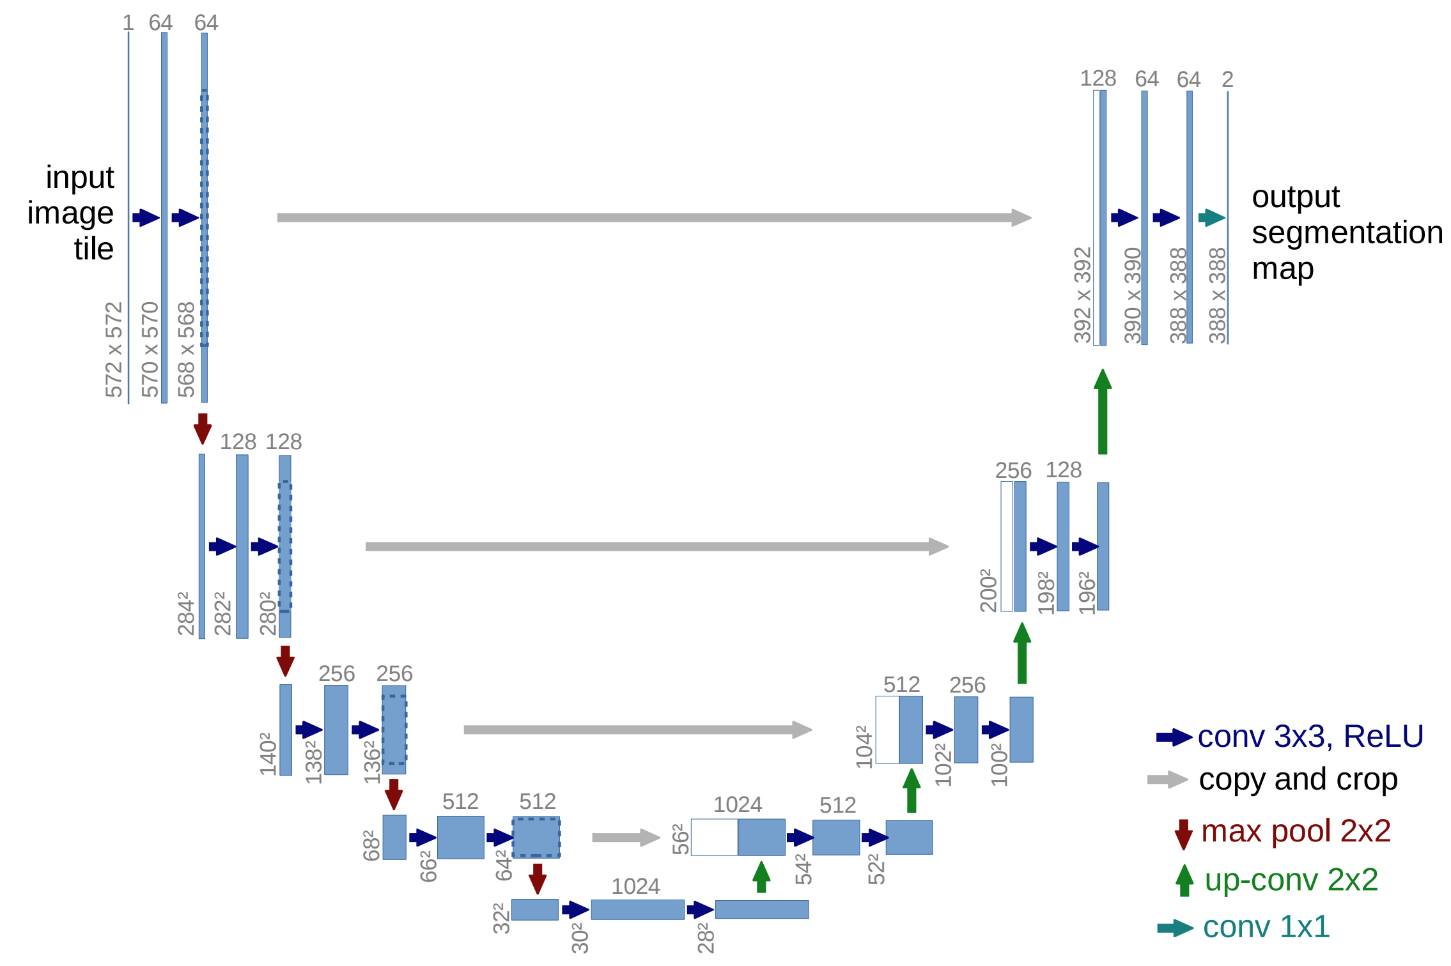
U-Net
Perhaps unsurprisingly, U-Net has a distinctive U-shaped architecture…
Notes:
U-Net is essentially made of the same components as the Autoencoder, and we follow a similar idea of making our images smaller and smaller and then expanding them again. However, there are some key differences here.
The first is the use of convolution.

Slide 31
U-Net
There are some key components of U-Net that are worth going over…
Convolution
Residuals
Upsampling
Pooling

Slide 32

U-Net
Convolution was a major advancement in machine vision
CNNs are essentially the reason why deep learning research exploded
Gradient-based Learning Applied to Document Recognition, 1998, LeCun et al, ~65k citations
ImageNet Classification with Deep Convolutional Neural Networks, 2012, Krizhevsky et al, ~130k citations
Notes:
Yann LeCun went on to win the Turing Award in 2018, and is the current Chief AI Scientist at Meta
Yoshua Bengio also one a turing award in 2018, and has the highest h-index of any computer scientist
The ImageNet paper authors immediately formed a company which was bought out by Google for the nice sum of $44m
Ilya Sutskever went on to be a co-author on the AlphaGo paper, and was a cofounder of OpenAI
Hinton also received the Turing award in 2018 and worked for Google Brain for over 10 years.

Slide 33
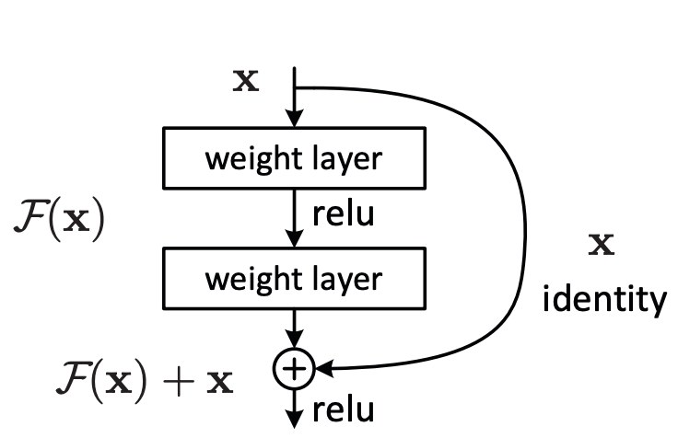
U-Net
Like CNNs, residual neural networks were a major step forward for deep learning.
Deep Residual Learning for Image Recognition, He et al, Microsoft Research, 2015 ~210k citations
Most neural networks now use residual connections.
After AlexNet, the main idea was simply to make the neural network bigger.
However, after a certain point, error appeared to increase that was not attributable to overfitting.
Instead of trying to learn a complicated function to transform the inputs directly to the outputs, we learn: “what do we need to change in order to transform the inputs to the outputs”
The trick is to add skip connections:
Notes:
The Resnet paper is the most highly cited paper on Google Scholar.
Deeper networks leads to a higher training error, but it is not due to overfitting. The argument for this is that:
Suppose I start with a shallow neural network.
In principle I should be able to just take my neural network, and add a bunch of layers afterwards that just learn the identity function. So it must be related to how the network weights are being optimized.

Slide 34

U-Net
Upsampling
In an autoencoder using convolutional filters, we have to go from our small bottleneck back to the original image size.
We use UpSampling for this:

Slide 35
U-Net
Let’s look at the U-Net architecture again…

Slide 36
CLIP
Notes:
My name is Ryan and I’m a machine learning engineer with the accelerate programme for scientific discovery. I’m just going to talk about accelerate, what we do, what we’ve done, and what we might be able to offer you.

Slide 37
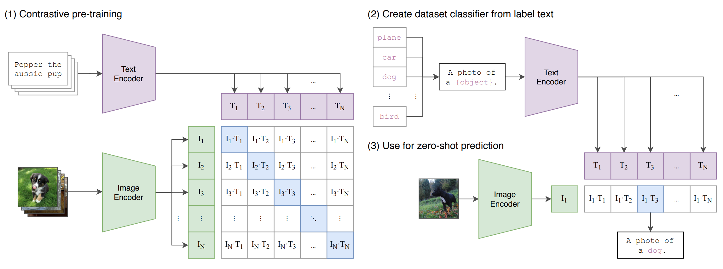
CLIP
Contrastive Language-Image Pre-training
Learning Transferable Visual Models for Natural Language Supervision, Radford et al, 2021, ~16k citations
Takes in images and texts and connects them together
Notes:
Scrape a bunch of photos and the accompanying text. Ask the question: How likely does a piece of text go with an image?
The prompt becomes important.
Take an image, and pass it through an encoder which will produce a vector in latent space. We do this for every image in a batch.
Take the text corresponding to the image and pass it through a different decoder which will produce another vector in latent space.
Now ask the model, which of the text is most appropriate for each image.

Slide 38
Diffusion
Notes:
My name is Ryan and I’m a machine learning engineer with the accelerate programme for scientific discovery. I’m just going to talk about accelerate, what we do, what we’ve done, and what we might be able to offer you.

Slide 39





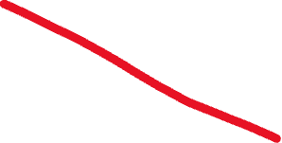
Diffusion
Back to this…
Notes:
We’ve covered these items, so now let’s think about the process itself, and how all of these are combined:
First, we scrape
First, an image is fed into an encoder to produce a latent representation.
The prompt is then fed into CLIP. The CLIP embedding is concatenated

Slide 40
Diffusion
Here is the algorithm for diffusion…
Notes:
Let’s return to this.

Slide 41
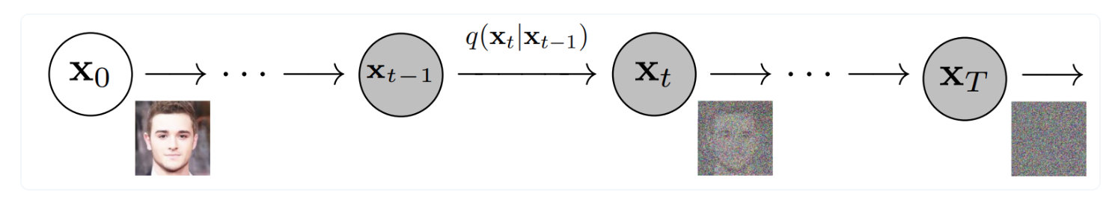
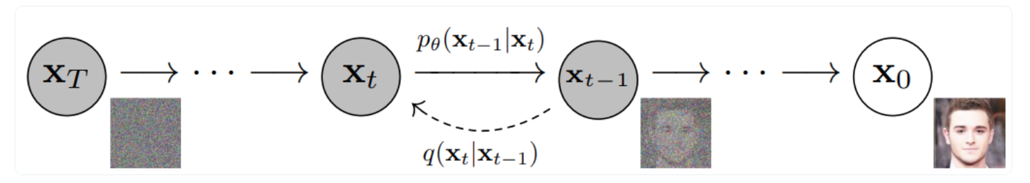
Diffusion
Diffusion models have a forward process and a reverse process...
Forward:
Reverse:
Notes:
In the forward process, noise is gradually added to an image until it becomes blurry, effectively simulating the process of milk diffusing through the coffee.
In the reverse process, we train a model to DENOISE the image gradually until we get back to a complicated distribution.
The key trick is learning this backward process

Slide 42
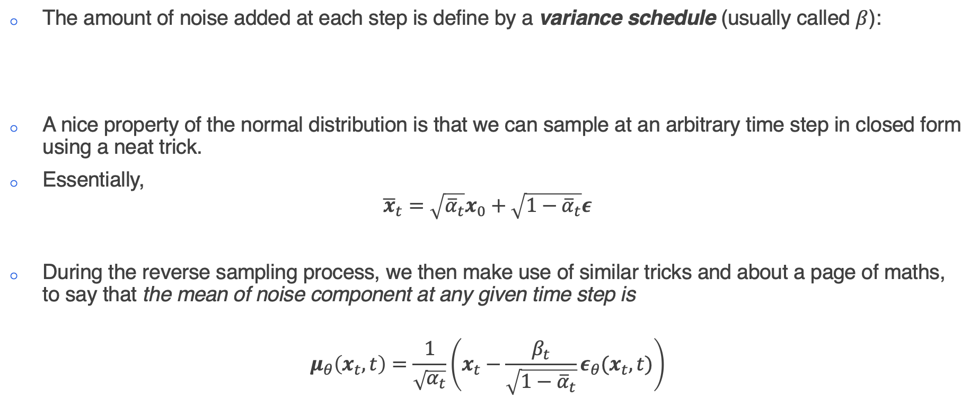
Diffusion
The choice of distribution make a few things easy for us...
The amount of noise added at each step is define by a variance schedule (usually called $β$):
A nice property of the normal distribution is that we can sample at an arbitrary time step in closed form using a neat trick.
Essentially,
$${\overline{x}}_{t}=\sqrt{{\overline{α}}_{t}}x_{0}+\sqrt{1−{\overline{α}}_{t}}ε$$
During the reverse sampling process, we then make use of similar tricks and about a page of maths, to say that the mean of noise component at any given time step is
$$μ_{θ}\left(x_{t},t\right)=\frac{1}{\sqrt{α_{t}}}\left(x_{t}−\frac{β_{t}}{\sqrt{1−{\overline{α}}_{t}}}ε_{θ}(x_{t},t)\right)$$

Slide 43
Diffusion
What does this mean?
We now know that we can simply take a random image, and add an amount of noise according to our variance schedule.
Instead of having our model predict exactly what the image is (i.e. denoise in one step), we have the model predict the amount of noise added at a particular timestep.
We then subtract this noise from the image, resulting in a slightly less noisy image.
During training, we are ensuring that the model pays very careful attention to when only a very little amount of noise is added, and takes small steps, whereas when much noise is added, we want to model to take bigger steps.
During sample, when we subtract noise from the image, we reinsert the less noisy image back into the model and repeat the process for a certain number of steps.

Slide 44
Diffusion
Here is the algorithm for diffusion…again…
Notes:
Let’s return to this.

Slide 45
Diffusion
Perhaps this makes more sense now…

